Slide 1
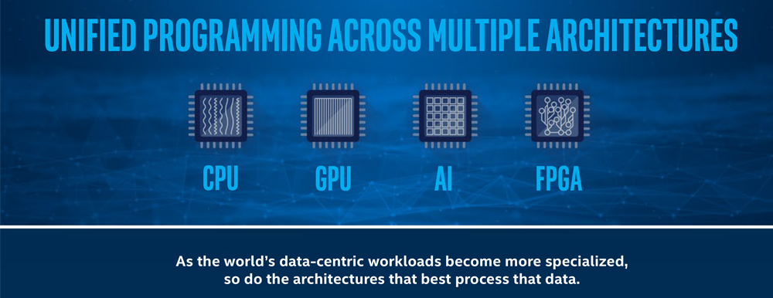
Intel oneAPI- AI in Agriculture
Notes:
What is OneAPI
oneAPI is an open, cross-industry, standards-based, unified, multiarchitecture, multi-vendor programming model that delivers a common developer experience across accelerator architectures – for faster application performance, more productivity, and greater innovation. The oneAPI initiative encourages collaboration on the oneAPI specification and compatible oneAPI implementations across the ecosystem.
-visit https://www.oneapi.io/
-Explore Elements of oneAPI at url https://www.oneapi.io/spec/
-SPEC 1.1

Slide 2
Agenda
Introduction to oneAPI and its Tools
Introduction to AI in Agriculture
Intel Distribution of Python
Intel DevCloud for oneAPI
Intel Extension for Scikit-Learn

Slide 3
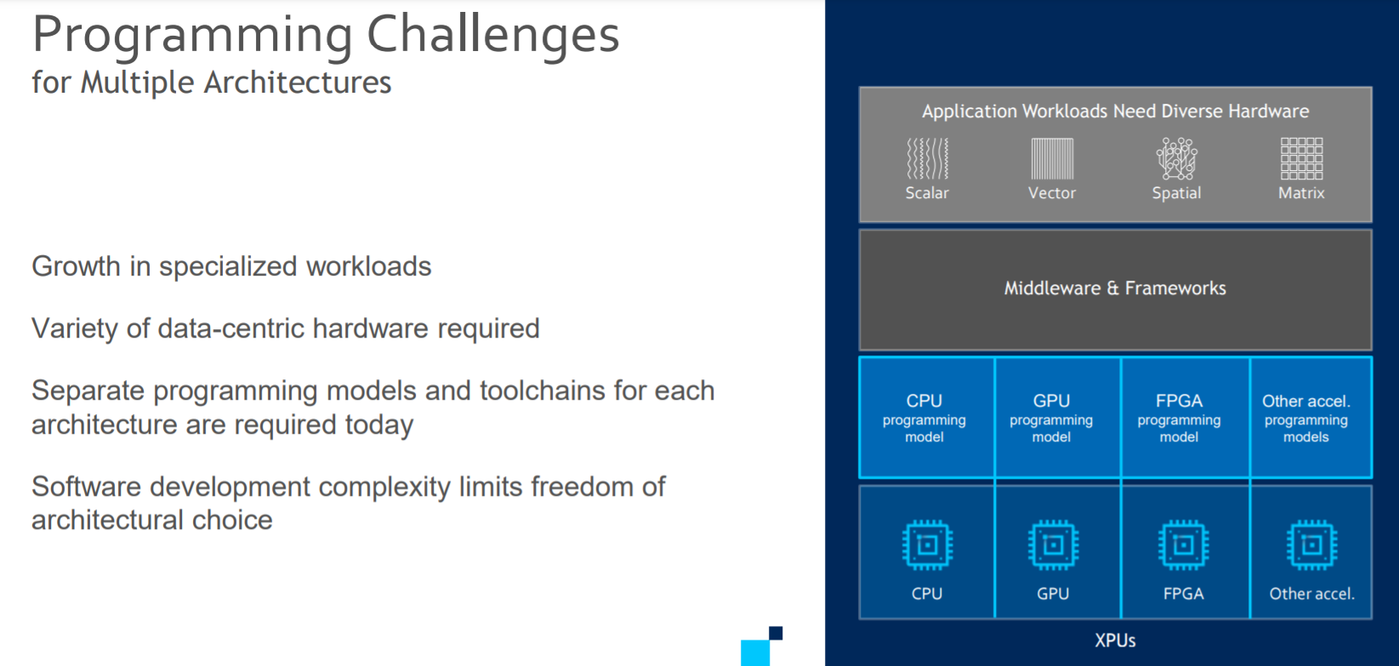

Slide 4
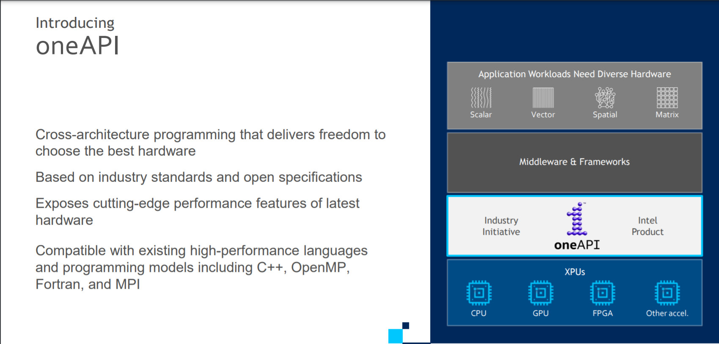

Slide 5
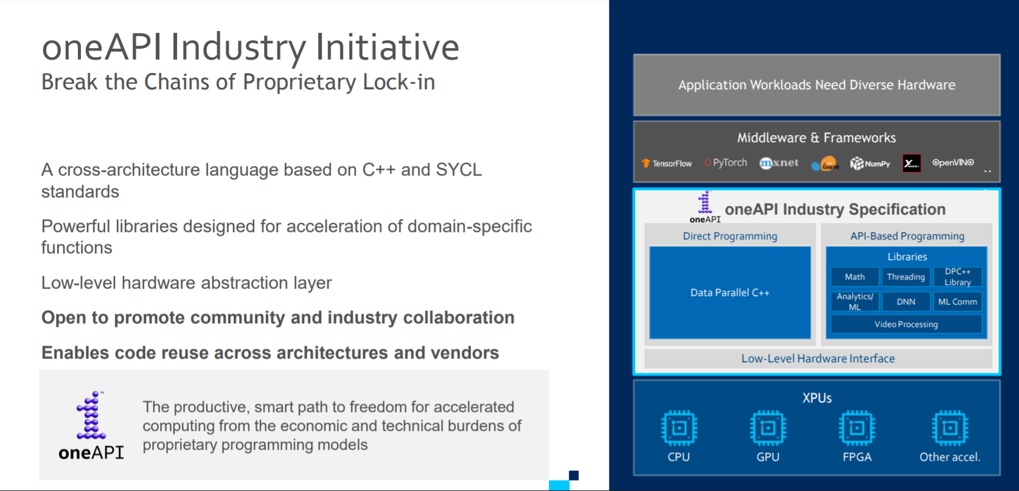

Slide 6
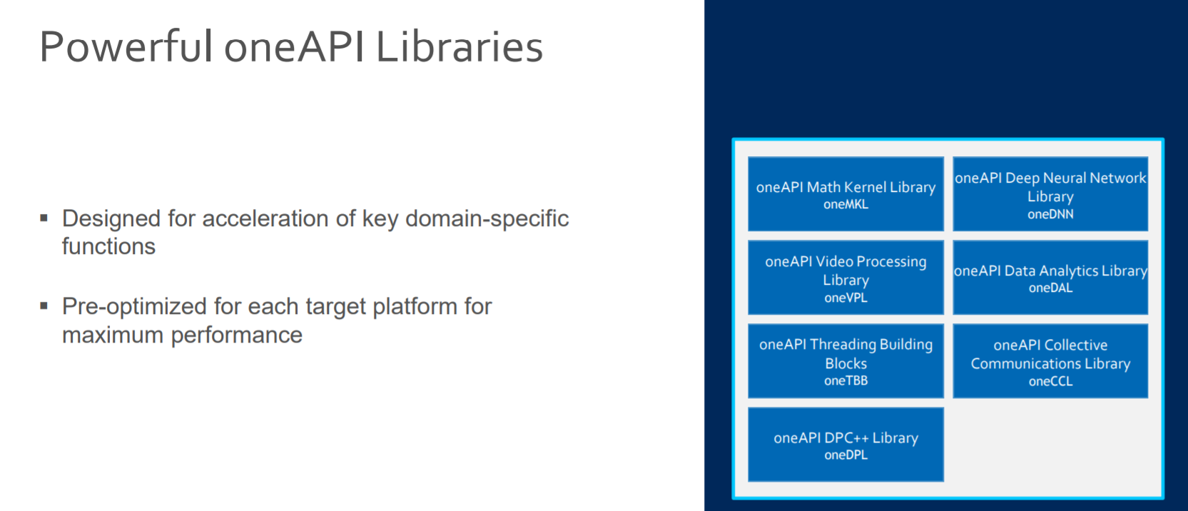

Slide 7
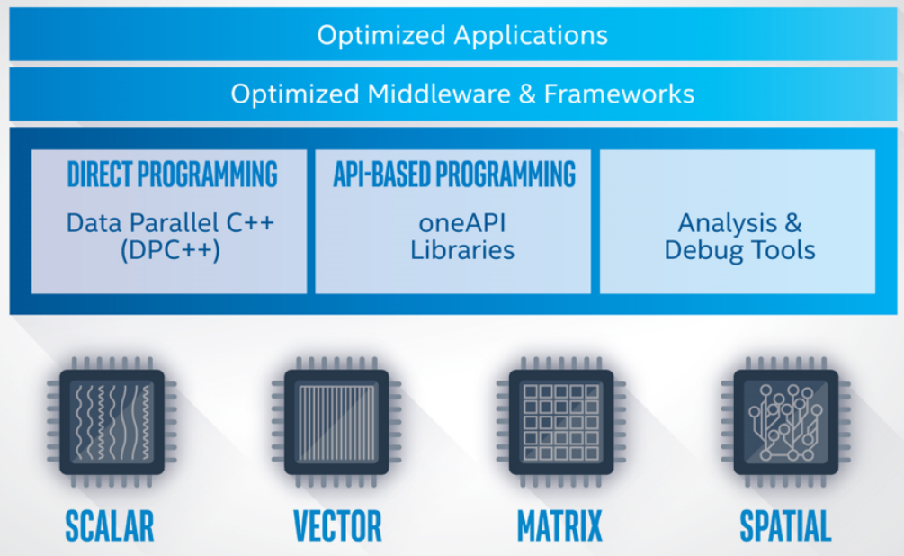
Intel OneAPI - Cross Architecture Performance
oneAPI is a cross-industry, open, standards-based unified programming model that delivers a common developer experience across accelerator architectures—for faster application performance, more productivity, and greater innovation.
The oneAPI industry initiative encourages collaboration on the oneAPI specification and compatible oneAPI implementations across the ecosystem.
Short Video Link
https://software.intel.com/content/www/us/en/develop/tools/oneapi.html#gs.36k4jr
Notes:
Intel Parallel Studio XE is a software development product developed by Intel that facilitates native code development on Windows, macOS and Linuxin C++ and Fortran for parallel computing.^{[2]} Parallel programming enables software programs to take advantage of multi-core processors from Intel and other processor vendors.
Intel Vtune amplifier- Stop guessing why software is slow. Advanced sampling and profiling techniques quickly analyze your code, isolate issues, and deliver insights for optimizing performance on modern processors.
Intel inspector- Locate and debug threading, memory, and persistent memory errors in applications early in the design cycle to avoid costly errors later.
Intel Advisor- Design and optimize high-performing code for modern computer architectures. Effectively use more cores, vectorization, and heterogeneous processing.

Slide 8
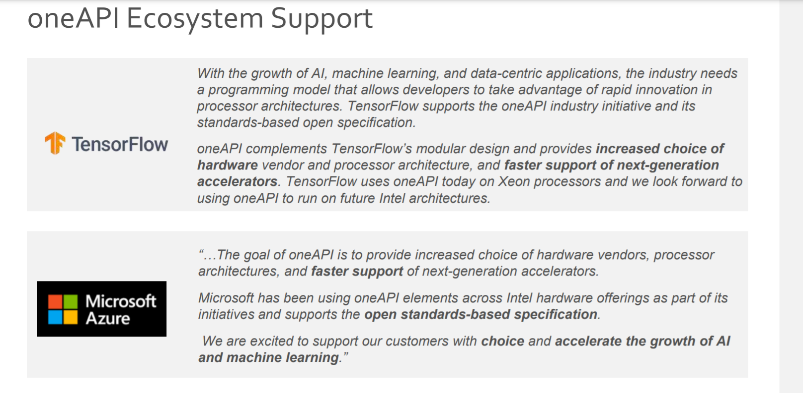

Slide 9
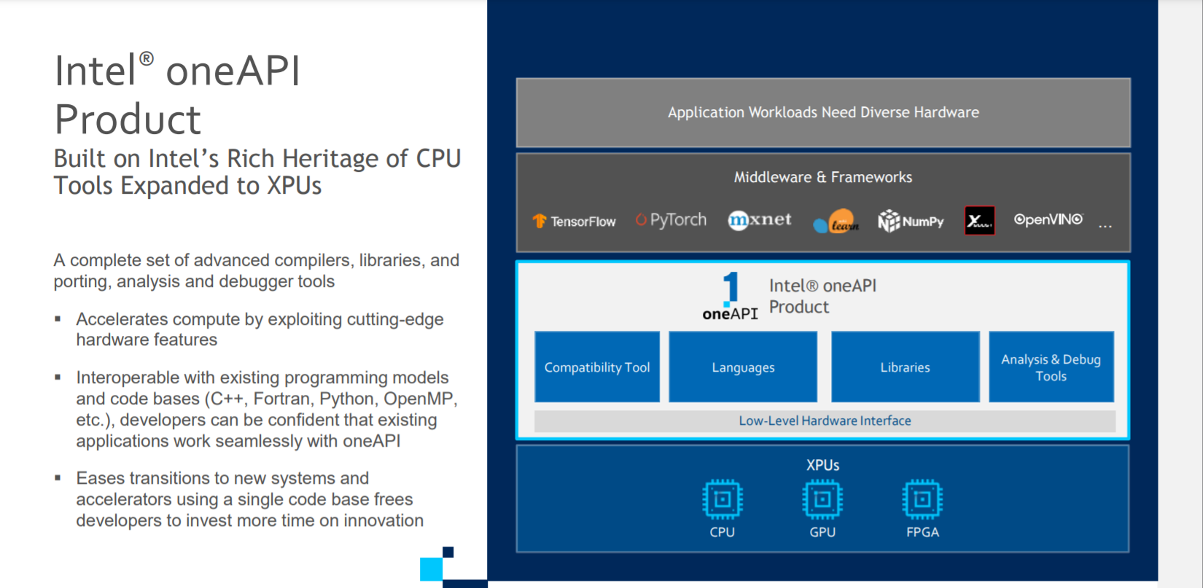

Slide 10
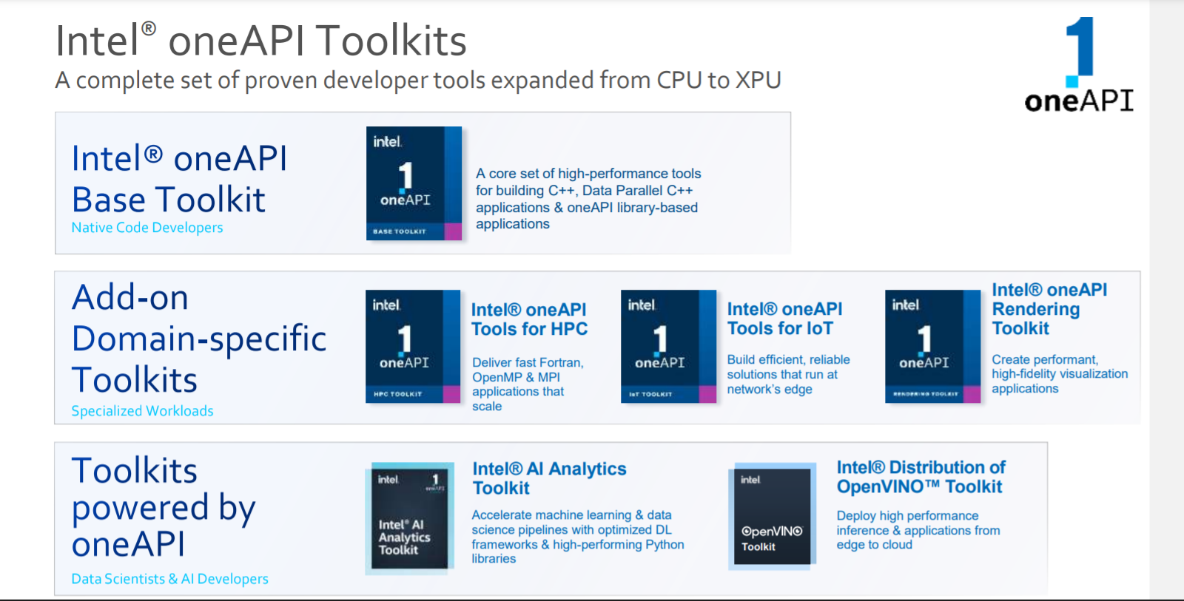

Slide 11
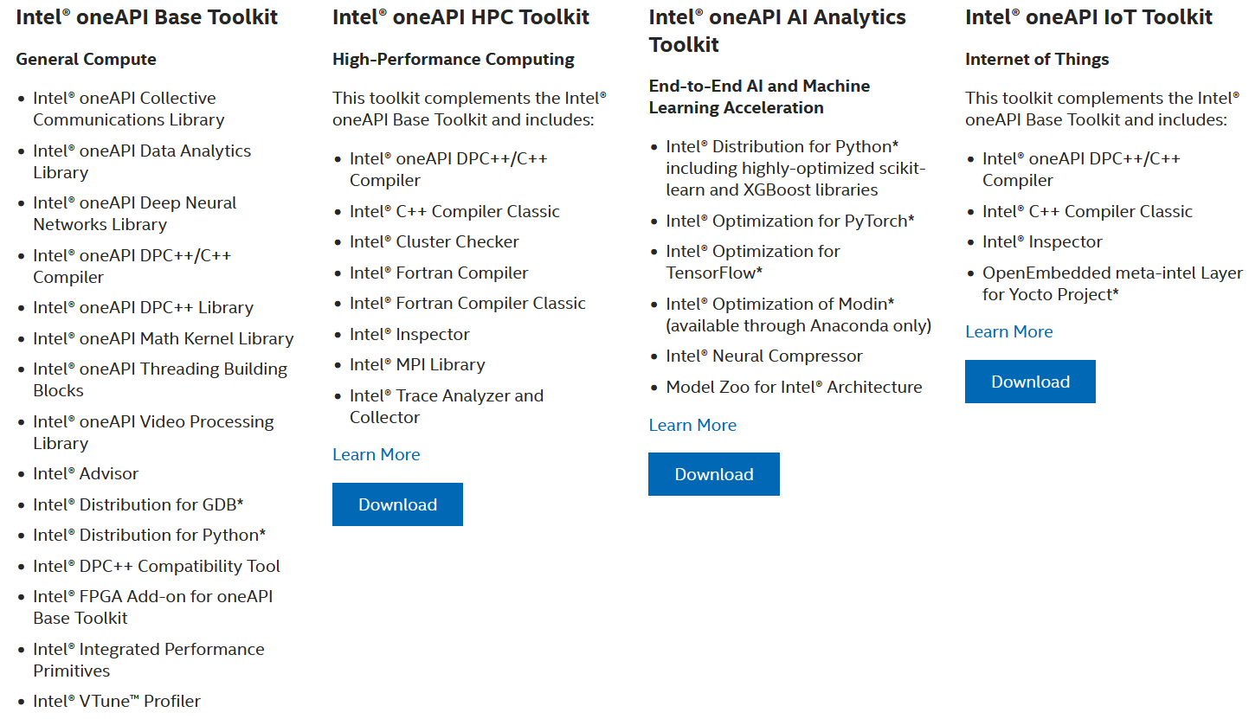
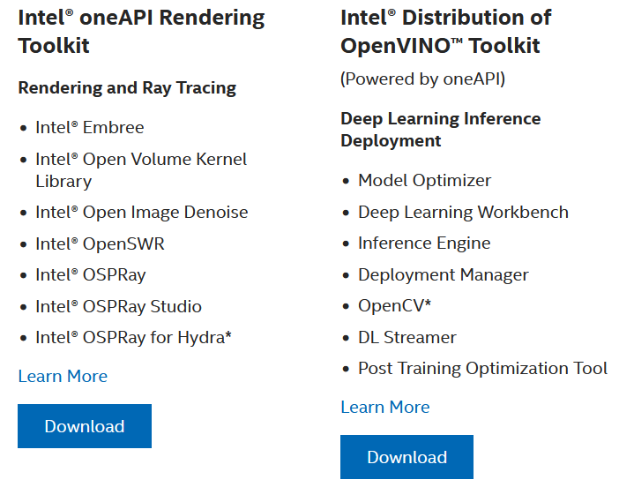
Intel OneAPI Toolkits
These toolkits are for performance-driven applications—HPC, IoT, advanced rendering, deep learning frameworks, and more—that are written in DPC++, C++, C, and Fortran languages.
Notes:
Intel Parallel Studio XE is a software development product developed by Intel that facilitates native code development on Windows, macOS and Linuxin C++ and Fortran for parallel computing.^{[2]} Parallel programming enables software programs to take advantage of multi-core processors from Intel and other processor vendors.
Intel Vtune amplifier- Stop guessing why software is slow. Advanced sampling and profiling techniques quickly analyze your code, isolate issues, and deliver insights for optimizing performance on modern processors.
Intel inspector- Locate and debug threading, memory, and persistent memory errors in applications early in the design cycle to avoid costly errors later.
Intel Advisor- Design and optimize high-performing code for modern computer architectures. Effectively use more cores, vectorization, and heterogeneous processing.

Slide 12
DPC++
oneAPI’s core language for programming accelerators and multiprocessors. DPC++ allows developers to reuse code across hardware targets (CPUs and accelerators such as GPUs and FPGAs) and tune for a specific architecture

Slide 13
OneDPL
A companion to the DPC++ Compiler for programming oneAPI devices with APIs from C++ standard library, Parallel STL, and extensions.
The oneAPI DPC++ Library (oneDPL) provides the functionality specified in the C++ standard, with extensions to support data parallelism and offloading to devices, and with extensions to simplify its usage for implementing data parallel algorithms.

Slide 14
OneDNN
High-performance implementations of primitives for deep learning frameworks
-oneAPI Deep Neural Network Library (oneDNN) is a performance library containing building blocks for for deep learning applications and frameworks. oneDNN supports:
CNN primitives (Convolutions, Inner product, Pooling, etc.)
RNN primitives (LSTM, Vanilla, RNN, GRU)
Normalizations (LRN, Batch, Layer)
Elementwise operations (ReLU, Tanh, ELU, Abs, etc.)
Softmax, Sum, Concat, Shuffle
Reorders from/to optimized data layouts
8-bit integer, 16-, 32-bit, and bfloat16 floating point data types

Slide 15
OneCCL
Communication primitives for scaling deep learning frameworks across multiple devices.
The oneAPI Collective Communications Library (oneCCL) provides primitives for the communication patterns that occur in deep learning applications. oneCCL supports both scale-up for platforms with multiple oneAPI devices and scale-out for clusters with multiple compute nodes.

Slide 16
Level Zero
A system interface for oneAPI languages and libraries

Slide 17
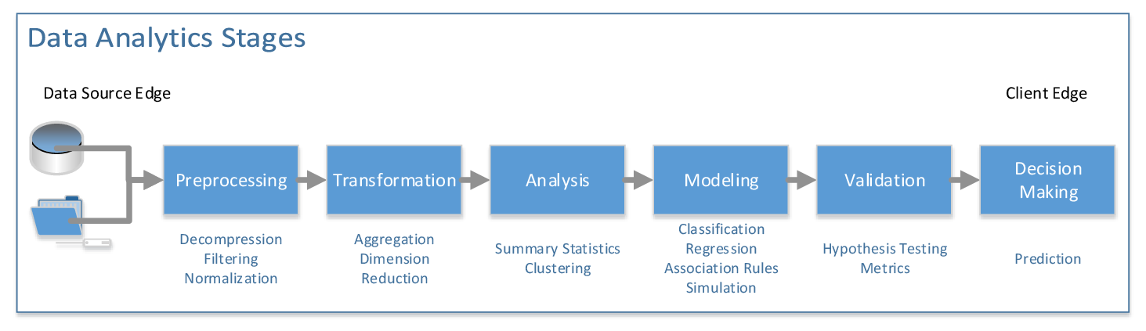
OneDAL
Algorithms for accelerated data science
oneDAL is a library that helps speed up big data analysis by providing highly optimized algorithmic building blocks for all stages of data analytics (preprocessing, transformation, analysis, modeling, validation, and decision making) in batch, online, and distributed processing modes of computation.

Slide 18
OneTBB
A library for adding thread-based parallelism to complex applications on multiprocessors.
oneTBB is a programming model for scalable parallel programming using standard ISO C++ code. A program uses oneTBB to specify logical parallelism in algorithms, while a oneTBB implementation maps that parallelism onto execution threads.

Slide 19
OneVPL
The oneAPI Video Processing Library (oneVPL) is a programming interface for video decoding, encoding, and processing to build portable media pipelines on CPUs, GPUs, and other accelerators. It provides device discovery and selection in media centric and video analytics workloads and API primitives for zero-copy buffer sharing. oneVPL is backwards and cross-architecture compatible to ensure optimal execution on current and next generation hardware without source code changes.

Slide 20
OneMKL
High-performance math routines for science, engineering, and financial applications
The oneAPI Math Kernel Library (oneMKL) defines a set of fundamental mathematical routines for use in high-performance computing and other applications. As part of oneAPI, oneMKL is designed to allow execution on a wide variety of computational devices: CPUs, GPUs, FPGAs, and other accelerators. The functionality is subdivided into several domains: dense linear algebra, sparse linear algebra, discrete Fourier transforms, random number generators and vector math.

Slide 21
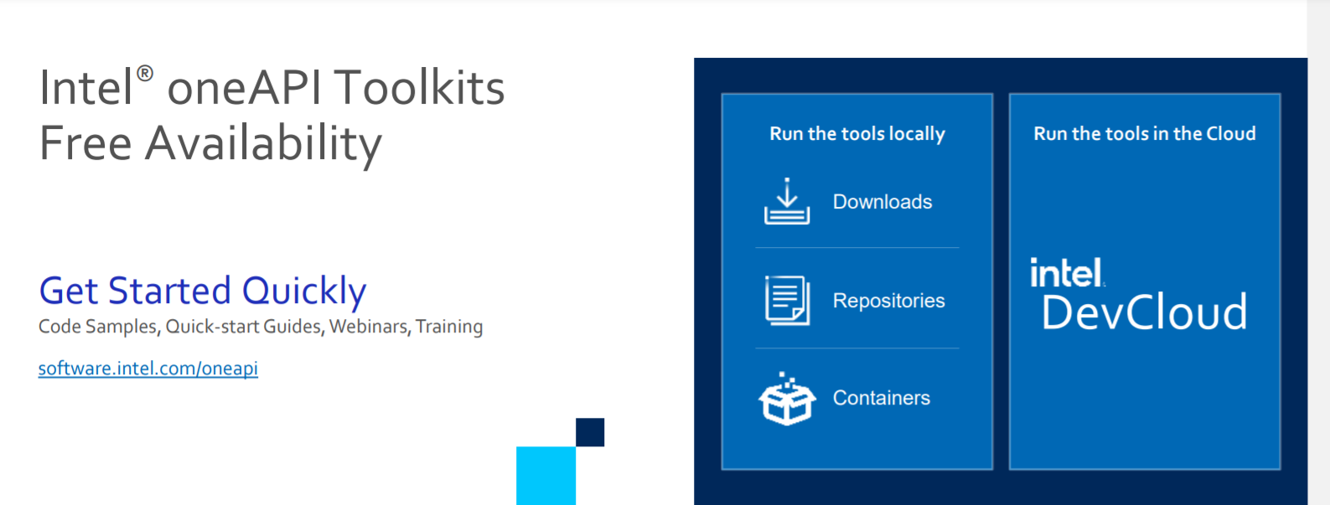
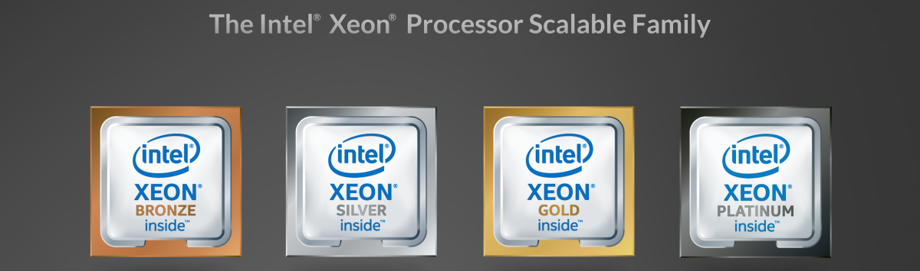
What is Intel Dev Cloud ?

Slide 22
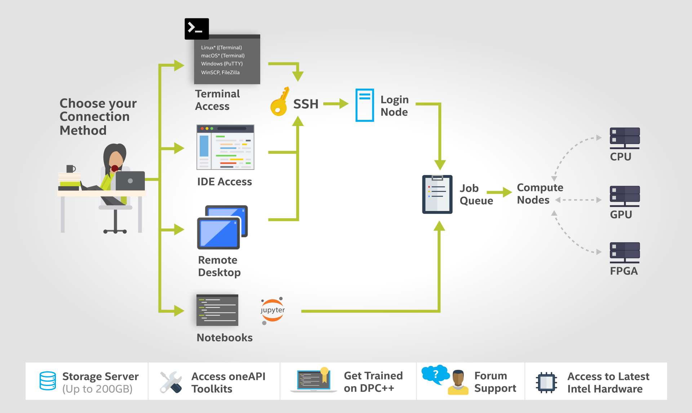
How DevCloud works?

Slide 23
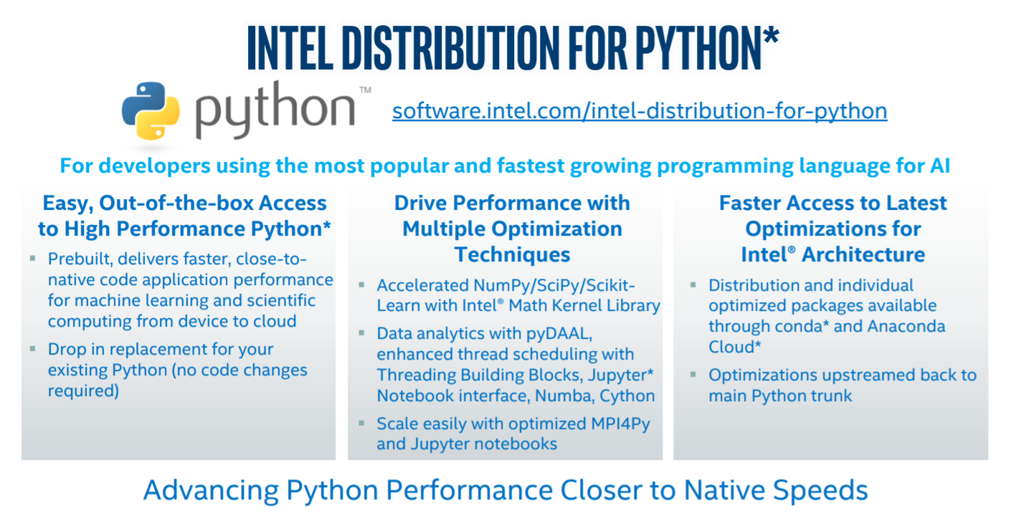

Slide 24
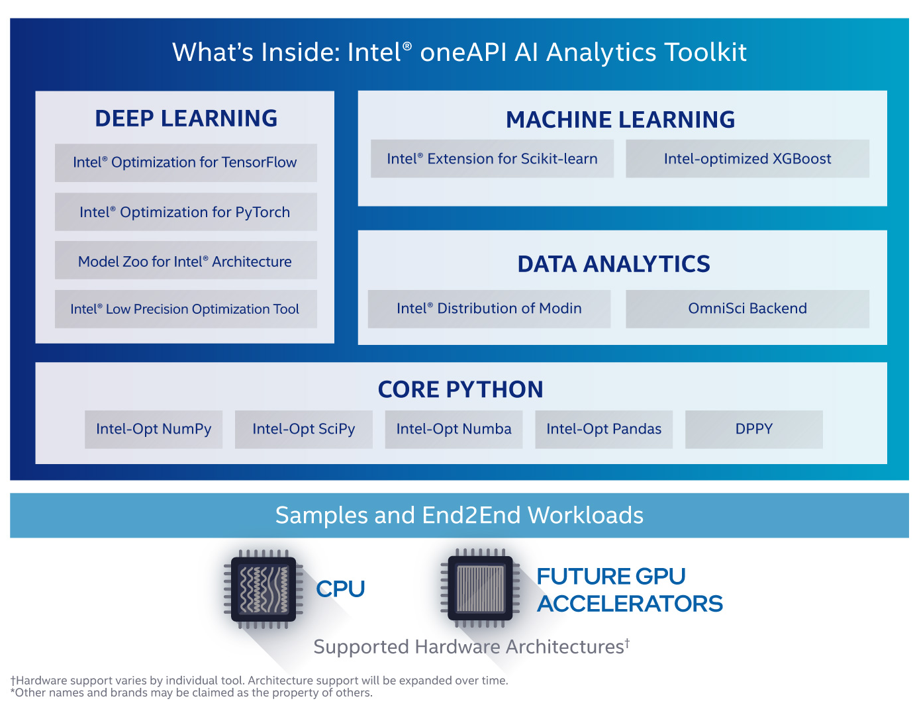

Slide 25
What software are required for this workshop?
Anaconda Software on Ubuntu
Intel Distribution of Python
Intel DevCloud for OneAPI

Slide 26
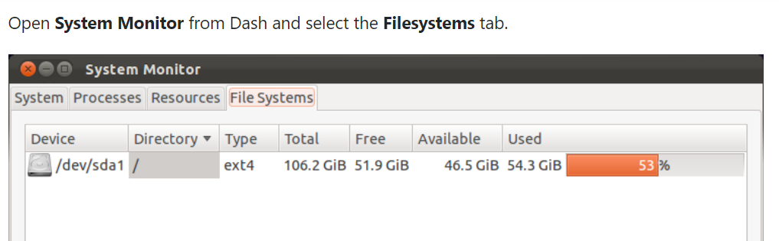
Important Ubuntu Commands
Check Ubuntu version
lsb_release –a
cat /etc/issue.net
Check Disk Space
df -h

Slide 27

Steps for downloading Intel Distribution of Python
Download Anaconda/Miniconda software
https://docs.anaconda.com/anaconda/install/linux/
Check Conda version
conda --version
Update Anaconda package
conda update conda

Slide 28
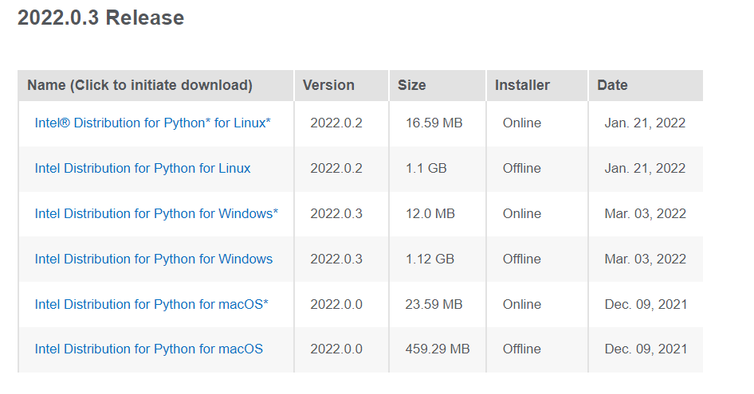
Intel Distribution of Python
https://www.intel.com/content/www/us/en/developer/articles/tool/oneapi-standalone-components.html#python

Slide 29
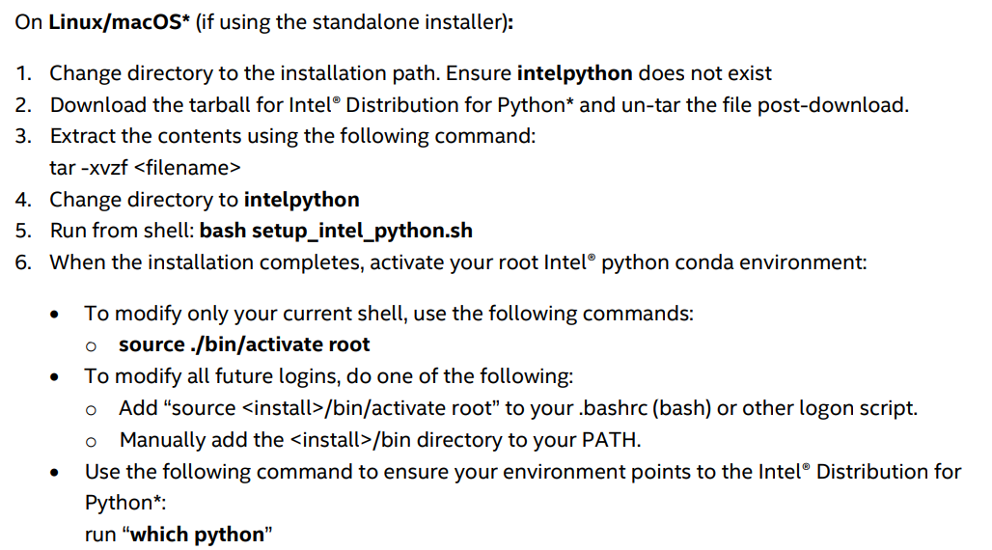
Intel Distribution of Python
https://www.intel.com/content/dam/develop/external/us/en/documents/2022_Python_Release_Notes_Intel(R)_Distribution_for_Python-Release1.pdf

Slide 30
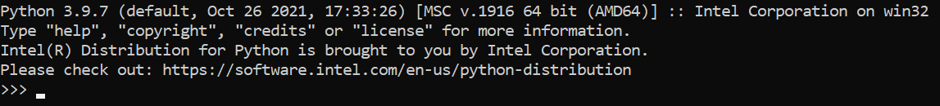
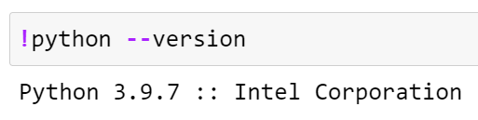
Checking if Python Intel is installed or not
On Anaconda Prompt, type python
In Jupyter Notebook, check the above statement in the code cell
Notes:
https://www.intel.com/content/www/us/en/developer/articles/tool/oneapi-standalone-components.html#python

Slide 31
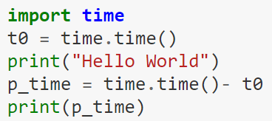
Time module in Python
%time
Use of time module from Python Standard library

Slide 32
How AI can be useful in agriculture
According to the Food and Agriculture Organization survey, the world population is expected to grow by another two billion by 2050, while the arable area is likely to grow only by 5%.
Farming entails a great deal of uncertainties such as climatic changes, fluctuating cost of agricultural material, crop damage by pests, etc.
Therefore, to increase the agriculture productivity efficient farming practises are required.
By using AI technology, the impact on natural ecosystems can be reduced which will help to keep food prices low and ensure that food production will keep up with the growing population.

Slide 33
Advantages
Analyzing market demand
AI can simplify crop selection and help farmers identify what produce will be most profitable.
Managing risk
Farmers can use forecasting and predictive analytics to reduce errors in business processes and minimize the risk of crop failures.

Slide 34
Advantages
Breeding seeds
By collecting data on plant growth, AI can help produce crops that are less prone to disease and better adapted to weather conditions.
Monitoring soil health
AI systems can conduct chemical soil analyses and provide accurate estimates of missing nutrients.

Slide 35
Advantages
Protecting crops
AI can monitor the state of plants to spot and even predict diseases, identify and remove weeds, and recommend effective treatment of pests.
Feeding crops
AI is useful for identifying optimal irrigation patterns and nutrient application times and predicting the optimal mix of agronomic products.
Harvesting
With the help of AI, it’s possible to automate harvesting and even predict the best time for it.

Slide 36
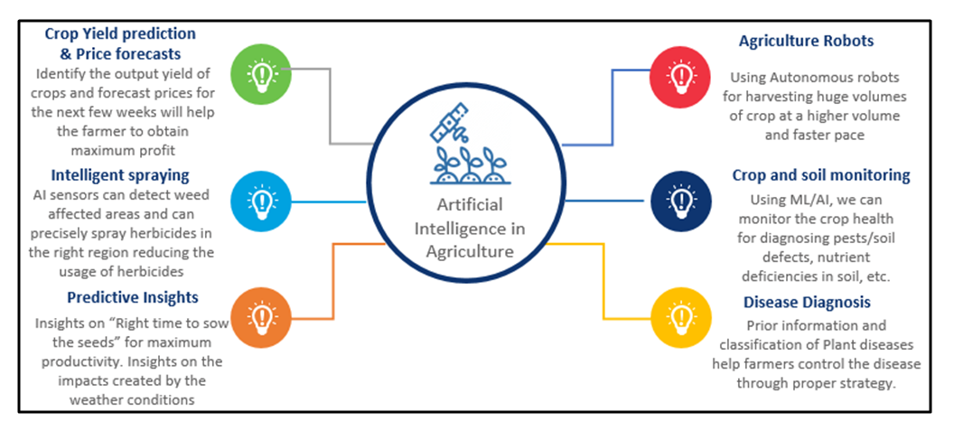
AI in Agriculture
Crop Yield prediction and Price forecasts
Agriculture Robots
Intelligent Spraying
Predictive Insights
Crop and soil monitoring
Disease Diagnosis
Source: https://www.wipro.com/holmes/towards-future-farming-how-artificial-intelligence-is-transforming-the-agriculture-industry.

Slide 37
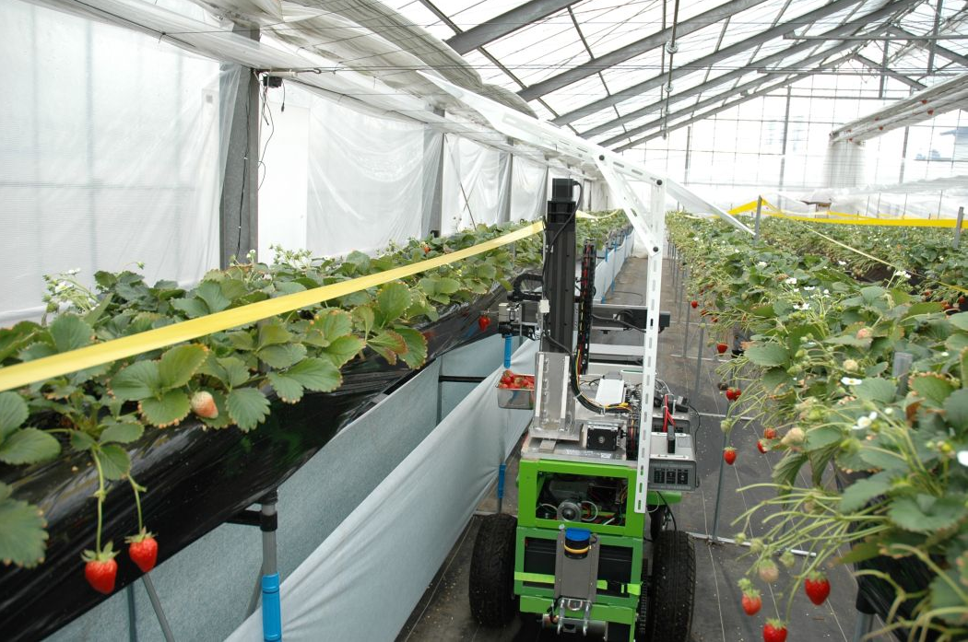
Harvesting Robot
It is made possible by using a stereo vision camera (basically allowing the robot to “see” in 3D like humans can) to discern where the strawberries are.
Specialized software quickly analyzes them to differentiate ripe from unripe berries.
The robotic arm is extended to the analyzed strawberry where its three fingers clamp the strawberry, pluck it from the strawberry plant, and deposit it onto a conveyor belt.
Source: http://www.lovingthemachine.com/2008/04/farmer-hails-strawberry-picking-robot.html

Slide 38
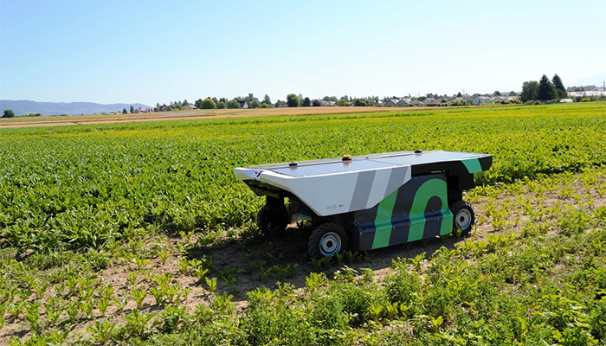
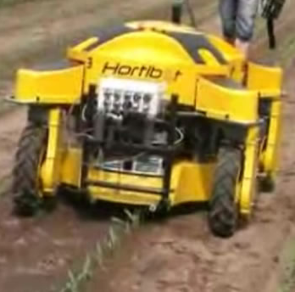
Weeding Robot
It helps to ensure a smaller environmental footprint.
It works by identifying flora that are dissimilar to the selected cultivar.
It ignores the crops, targeting the weed with a mini dose of herbicide, allowing farmers to use 90 percent less.
Source: https://www.roboticsbusinessreview.com/agriculture/the-next-frontier-of-weeding-robots/

Slide 39
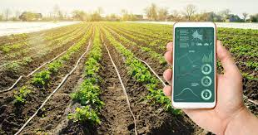
Crop health monitoring
Soil condition monitoring sensors allow farmers to collect data about rainfall, temperature, and other metrics over time to track trends and predict irrigation needs.
Farmers will save time that’s usually spend manually checking crop water levels because sensors can give them real-time information instantly on almost any online device.
Sensors allow for better water conservation while ensuring there isn’t over or underwatering of crops.
IOT-enabled sensors take very little time to set up and there is a long battery life, which leads to less maintenance costs.
Source: https://www.biz4intellia.com/blog/crop-health-monitoring-with-iot-enabled-precision-agriculture-solution/

Slide 40
Role of Intel in Agriculture
A new project launched by the International Fund for Agricultural Development (IFAD) and Intel Corporation is providing smallholder farmers in the Kingdom of Cambodia simple technologies that can help the country reach its goal of becoming the next major rice exporter in the global market.
The new project provides smallholder farmers a step-by-step software programme to analyse soil, determine fertiliser requirements, advise on best seeds and deal with pests and diseases.
The software gives them immediate access to a pool of specialists and all the knowledge they need is at their fingertips.
The software from Intel corporation is being used in India, where it has helped small farmers increase their production by around 300 per cent.

Slide 41
Conclusion
The benefits of AI in agriculture are undeniable.
Smart farming tools and vertical farming systems can perform small, repeatable, and time-consuming tasks so farm workers can use their time for more strategic operations that require human intelligence.
However, it’s important to realize that unlike a tractor, one can’t just buy AI and start it.
AI is just the next step in the development of smart farming, and it needs other technology to actually work.

Slide 42
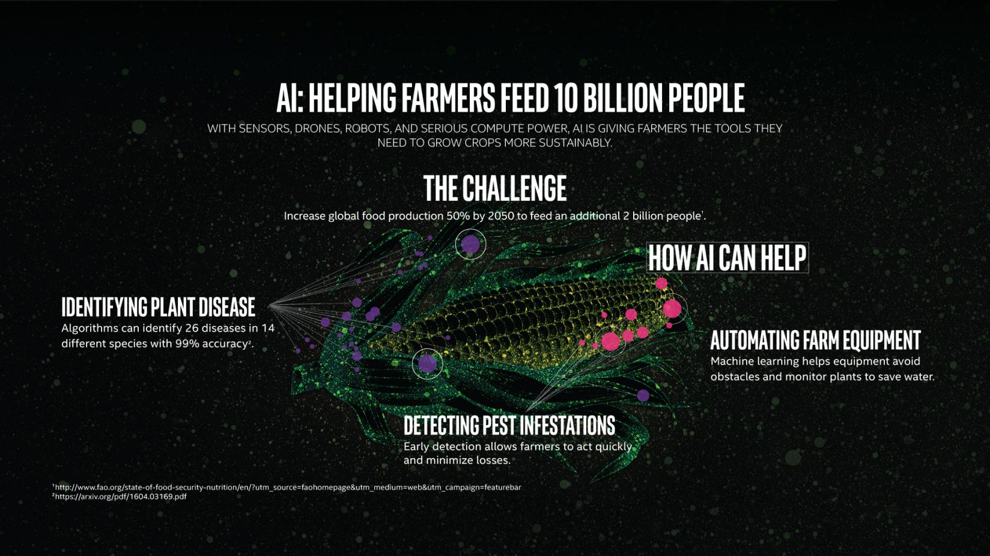
Conclusion
Source: https://www.intel.com/content/www/us/en/big-data/article/agriculture-harvests-big-data.html

Slide 43

Please contact
Foundation for Innovation and Collaborative
Education
mentor@fice.in
www.fice.in
Please contact
Foundation for Innovation and Collaborative
Education
info@fice.in
mentor@fice.in
Notes:
Here are the lessons we are going to learn today.

